Slide 1

Course Id :INT 213

Slide 2
PART II-PANDAS

Slide 3
I INTRODUCTION

Slide 4
Pandas
Pandas is probably the most powerful library in Data analysis.
It provides high-performance tools for data manipulation and analysis.
Furthermore, it is very effective at converting data formats and querying data out of databases.
The two main data structures of Pandas are :
series
data frame
To work with Pandas, we need to import the module.
import pandas as pd

Slide 5
II SERIES

Slide 6
Series
A series in Pandas is a one-dimensional array which is labeled.
You can imagine it to be the data science equivalent of an ordinary Python dictionary.
In order to create a series, we use the constructor of the Series class. The first parameter that we pass is a list full of values (in this case numbers). The second parameter is the list of the indices or keys.

Slide 7
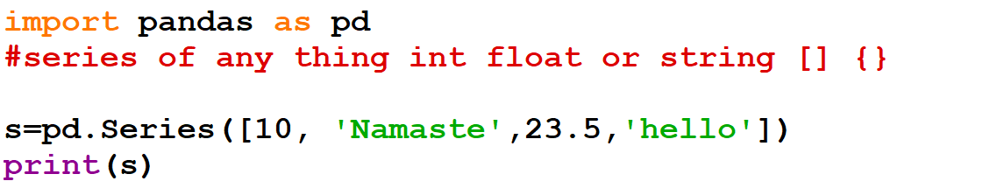
Series

Slide 8
Changing the index of an element
import pandas as pd
s=pd.Series([1,2,3,4,5],
[ 'a','b','c','d',’e’])
print(s)
import pandas as pd
s=pd.Series([1,2,3,4,5],index=['a','b','c','d','e’])
print(s)

Slide 9
Converting Dictionaries into Series
Since series and dictionaries are quite similar, we can easily convert our Python dictionaries into Pandas series.
import pandas as pd
myDict = {'A':10, 'B':20, 'C':30}
series=pd.Series(myDict)
print(series)
print(series['A'])

Slide 10
Changing the index of the element
import pandas as pd
myDict = {'A':10, 'B':20, 'C':30}
series=pd.Series(myDict,index=['C','A','B’])
print(series)
print(series['B'])
import pandas as pd
myDict = {'A':10, 'B':20, 'C':30}
series=pd.Series(myDict,index=['X','Y','Z’])
print(series)
print(series['X'])

Slide 11
Accessing a value
import pandas as pd
s =pd.Series([1,2,3,4,5])
print(s)
print(s[1])
import pandas as pd
s=pd.Series([1,2,3,4,5],['a','b','c','d','e’])
print(s)
print(s['c’])
print(s[2])

Slide 12
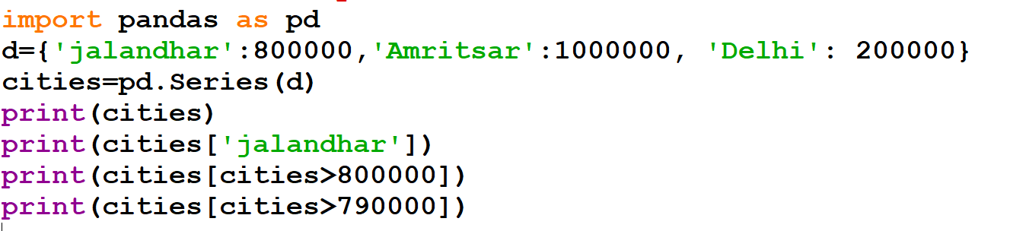
What is the output of the code?

Slide 13
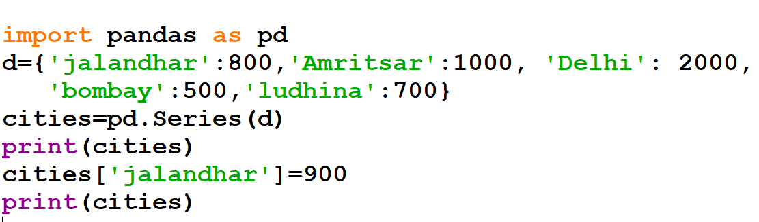
What is the output of the code?

Slide 14
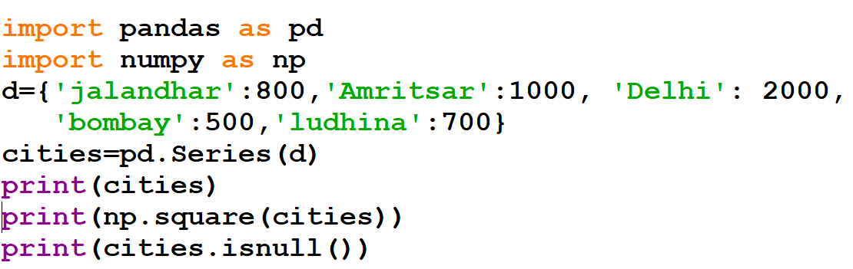
What is the output of the code?

Slide 15
III DATAFRAME

Slide 16
Dataframe
In contrast to the series, a data frame is not one-dimensional but multi-dimensional and looks like a table.
You can imagine it to be like an Excel table or a data base table.

Slide 17
Dataframe
import pandas as pd
data = {'Name': ['Anna', 'Bob', 'Charles’],
'Age': [24, 32, 35],
'Height': [176, 187, 175]
}
d=pd.DataFrame (data)
print(d)

Slide 18
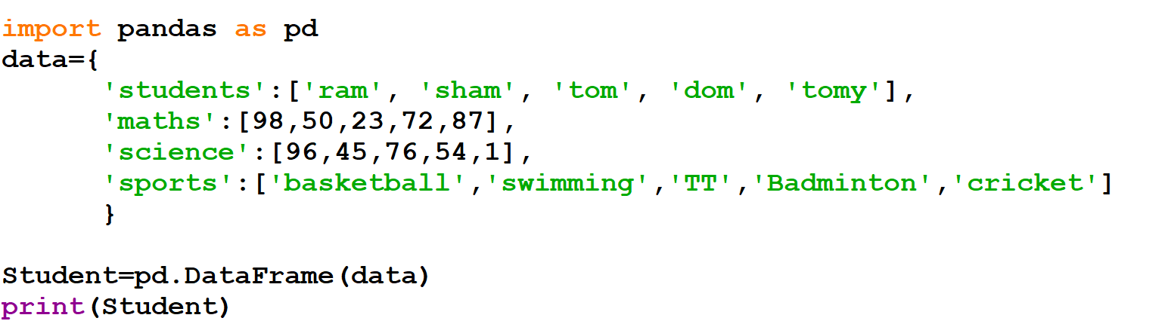
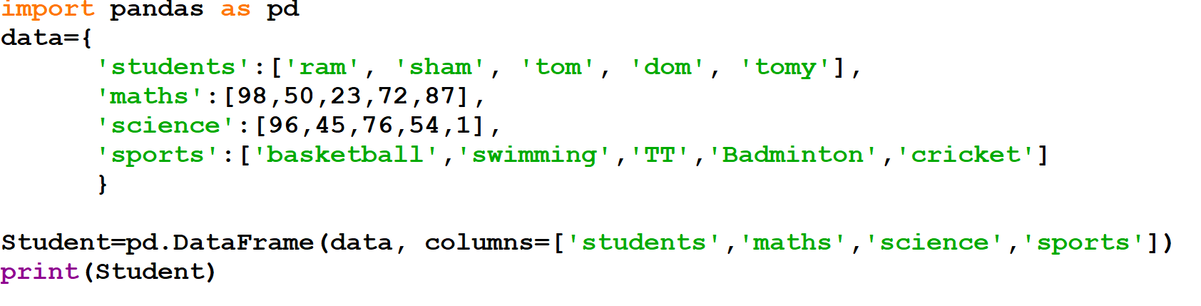
Dataframes

Slide 19
Accessing a value
import pandas as pd
data = {'Name': ['Anna', 'Bob', 'Charles'], 'Age': [24, 32, 35],'Height': [176, 187, 175]}
d=pd.DataFrame (data)
print(d)
print(d['Name'][1])

Slide 20
Extracting selected columns
import pandas as pd
data = {'Name': ['Anna', 'Bob', 'Charles'], 'Age': [24, 32, 35],'Height': [176, 187, 175]}
d=pd.DataFrame (data)
print(d)
print(d[['Name','Height']])

Slide 21
IV DATAFRAME FUNCTIONS

Slide 22
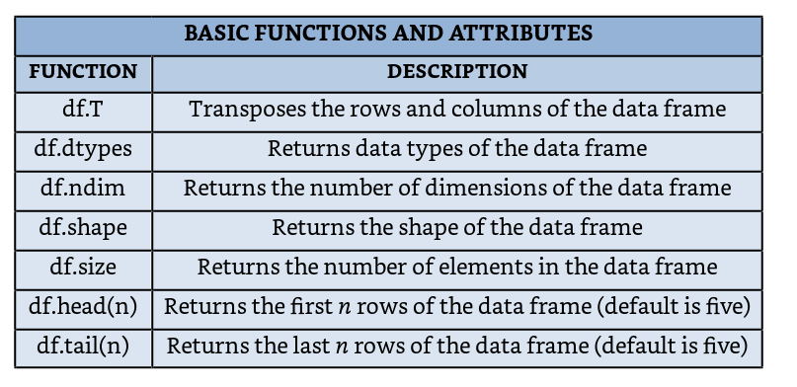
(A) Basic Functions

Slide 23
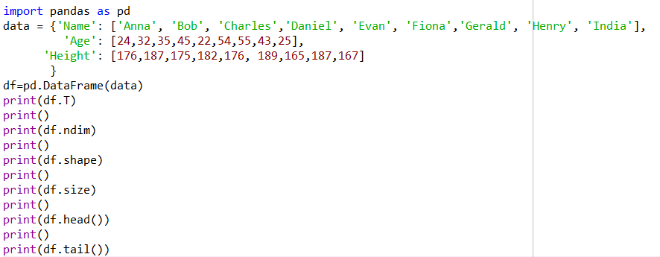
How to use basic functions?

Slide 24
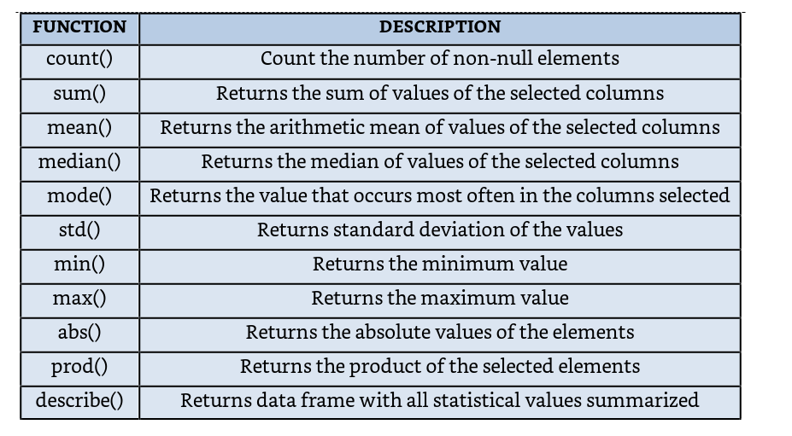
(B) Statistical Functions

Slide 25
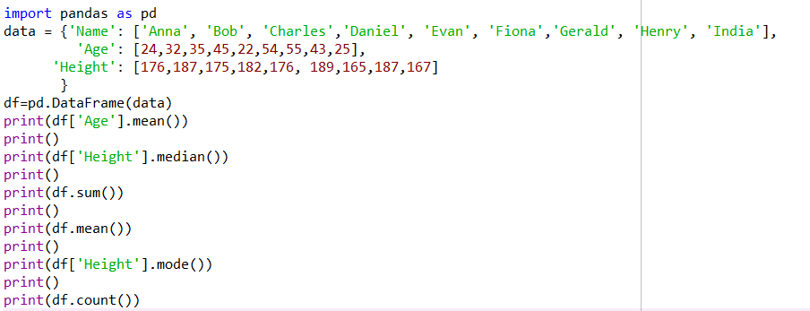
How to use statistical functions?

Slide 26
(C) Numpy Functions
Instead of using the built-in Pandas functions, we can also use the methods we already know.
For this, we just use the apply function of the data frame and then pass our desired method.

Slide 27
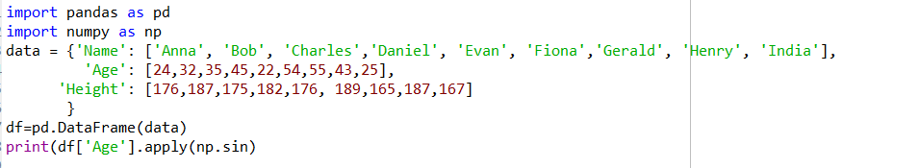
How to use Numpy function in pandas?

Slide 28
V ITERATING

Slide 29
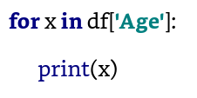
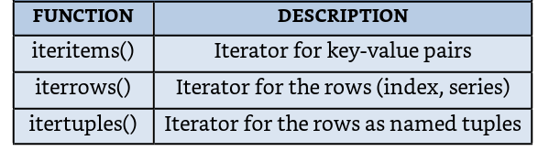
Iterating
Iterating over data frames is quite easy with Pandas. We can either do it in the classic way or use specific functions for it.

Slide 30
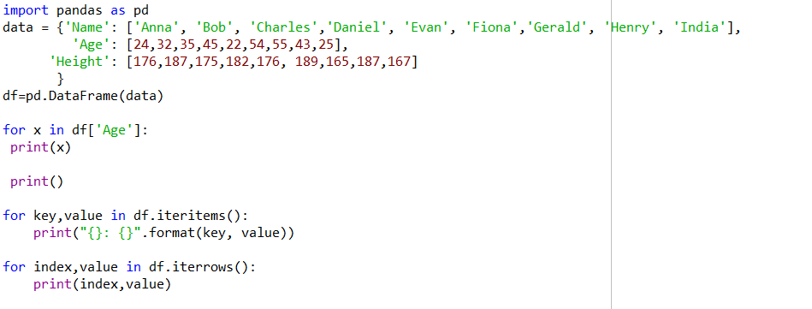
How to iterate in pandas?

Slide 31
VI SORTING

Slide 32
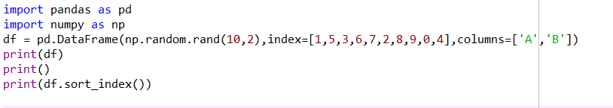
(A) Sorting by Index

Slide 33
Inplace parameter
When we use functions that manipulate our data frame, we don’t actually change it but we return a manipulated copy. If we wanted to apply the changes on the actual data frame, we would need to do it like this:
df = df.sort_index()
But Pandas offers us another alternative as well. This alternative is the parameter inplace. When this parameter is set to True, the changes get applied to our actual data frame.
df.sort_index(inplace=True)

Slide 34
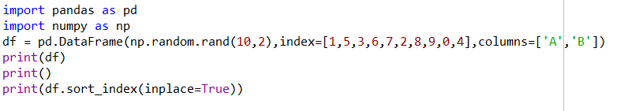
Inplace parameter

Slide 35
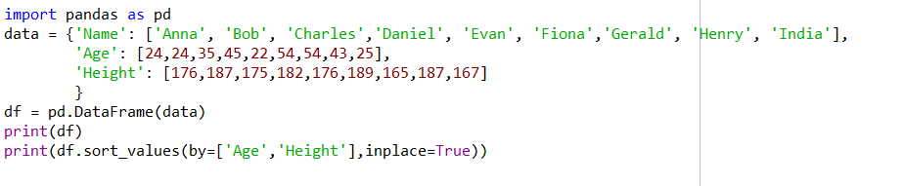
(B) Sort by Column

Slide 36
VII CSV FILE

Slide 37

Reading data from csv file

Slide 38
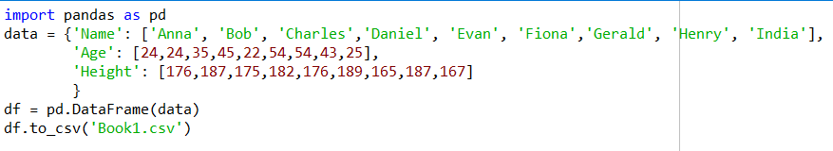
Writing data into csv files

Slide 39
VIII JOINING AND MERGING

Slide 40
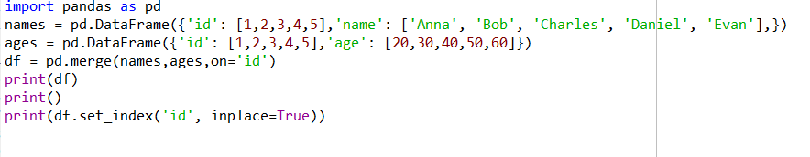
Merging

Slide 41
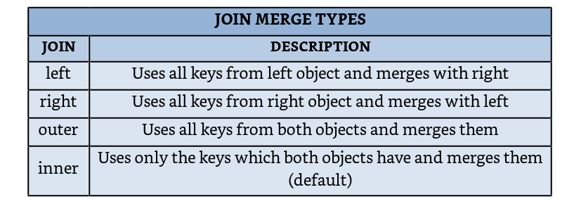
Joining

Slide 42
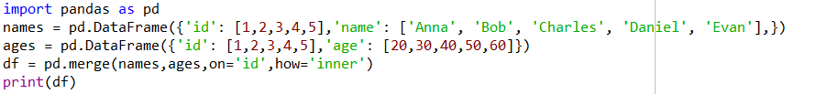
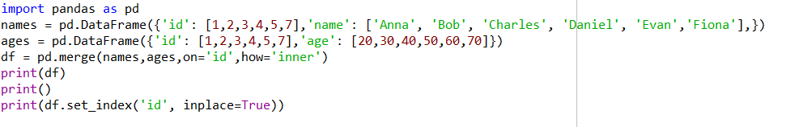
Inner join

Slide 43
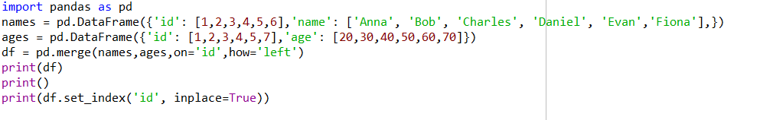
Left join

Slide 44
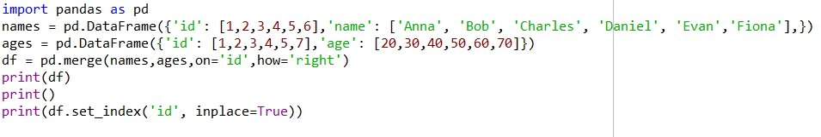
Right join

Slide 45
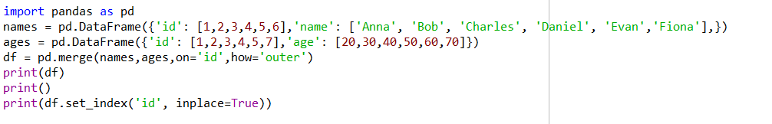
Outer join

Slide 46
IX QUERYING DATA

Slide 47
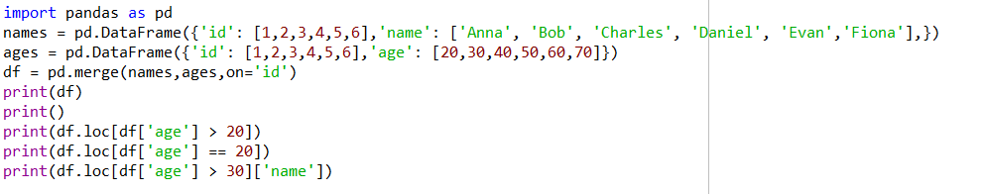
Extracting Selected Data

Slide 48
X Working on CSV files

Slide 49
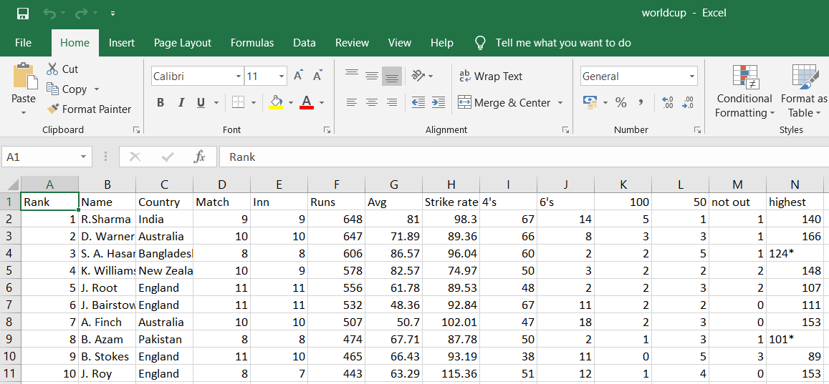
CSV file 1: ’ worldcup.csv’

Slide 50
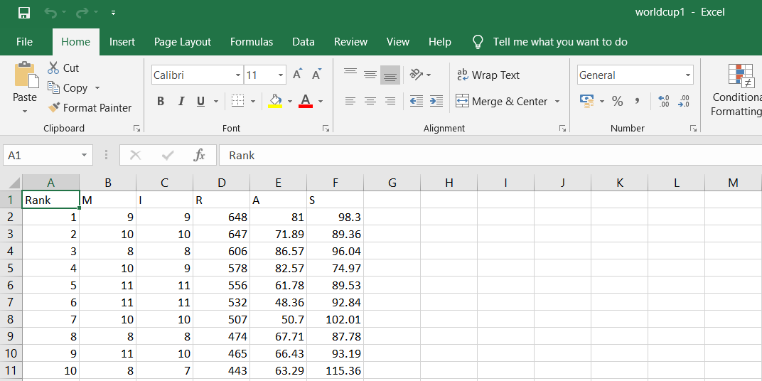
CSV file 2: ’ worldcup1.csv’

Slide 51
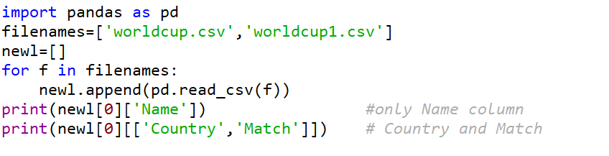
Extracting selected columns

Slide 52
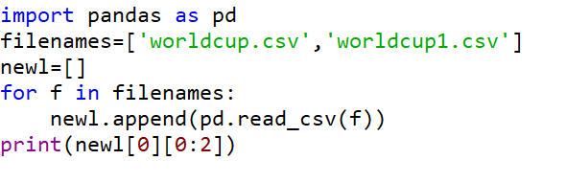
Extracting selected rows

Slide 53
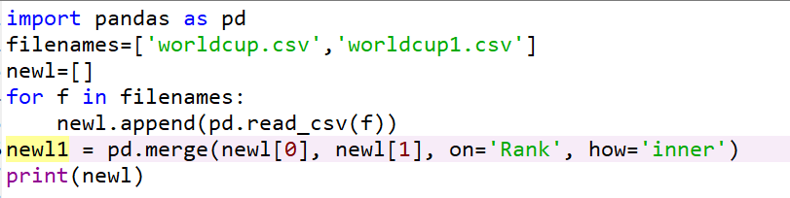
Merging the files

